Slide 1


API ACTIVITIES
Team:
Tushar Jain
Y. Nandita
S. Bhavana
K. Sasi Kiran

Slide 2
Introduction To API
What is API?
API full form is Application Programming Interface that is a collection of communication protocols and subroutines used by various programs to communicate between them.
Postman: Postman is an API(application programming interface) development tool which helps to build, test and modify APIs. Almost any functionality that could be needed by any developer is encapsulated in this tool.

Slide 3
base URL
In Postman, you can set up a base URL for your requests to simplify the process. Here are a couple of ways to achieve this:
Using Environment Variables:
Create a new environment in Postman.
Add an environment variable with the desired base URL (e.g., base-url).
In your requests, use the environment variable by enclosing it in double curly braces: {{base-url}}.
When you send the request, Postman will replace {{base-url}} with the actual value from the environment1.
2. Collection-Level Pre-Request Script:
Set up a pre-request script at the collection level (or folder level if needed).
In the pre-request script, modify the pm.request.url.protocol and pm.request.url.host properties to set your desired base URL.
Base URL: petstore.swagger.io/v2

Slide 4
Swagger UI
Swagger UI is a open-source tool that allows developers to visualize and interact with the APIs they are working with. It is commonly integrated into API development platforms like Postman to provide a more user-friendly interface for exploring and testing APIs.
Postman itself is a popular collaboration platform for API development. It allows developers to design, build, and test APIs more efficiently. With the integration of Swagger UI, developers can import their API specifications, such as OpenAPI (formerly Swagger) documents, into Postman and then visualize and interact with

Slide 5
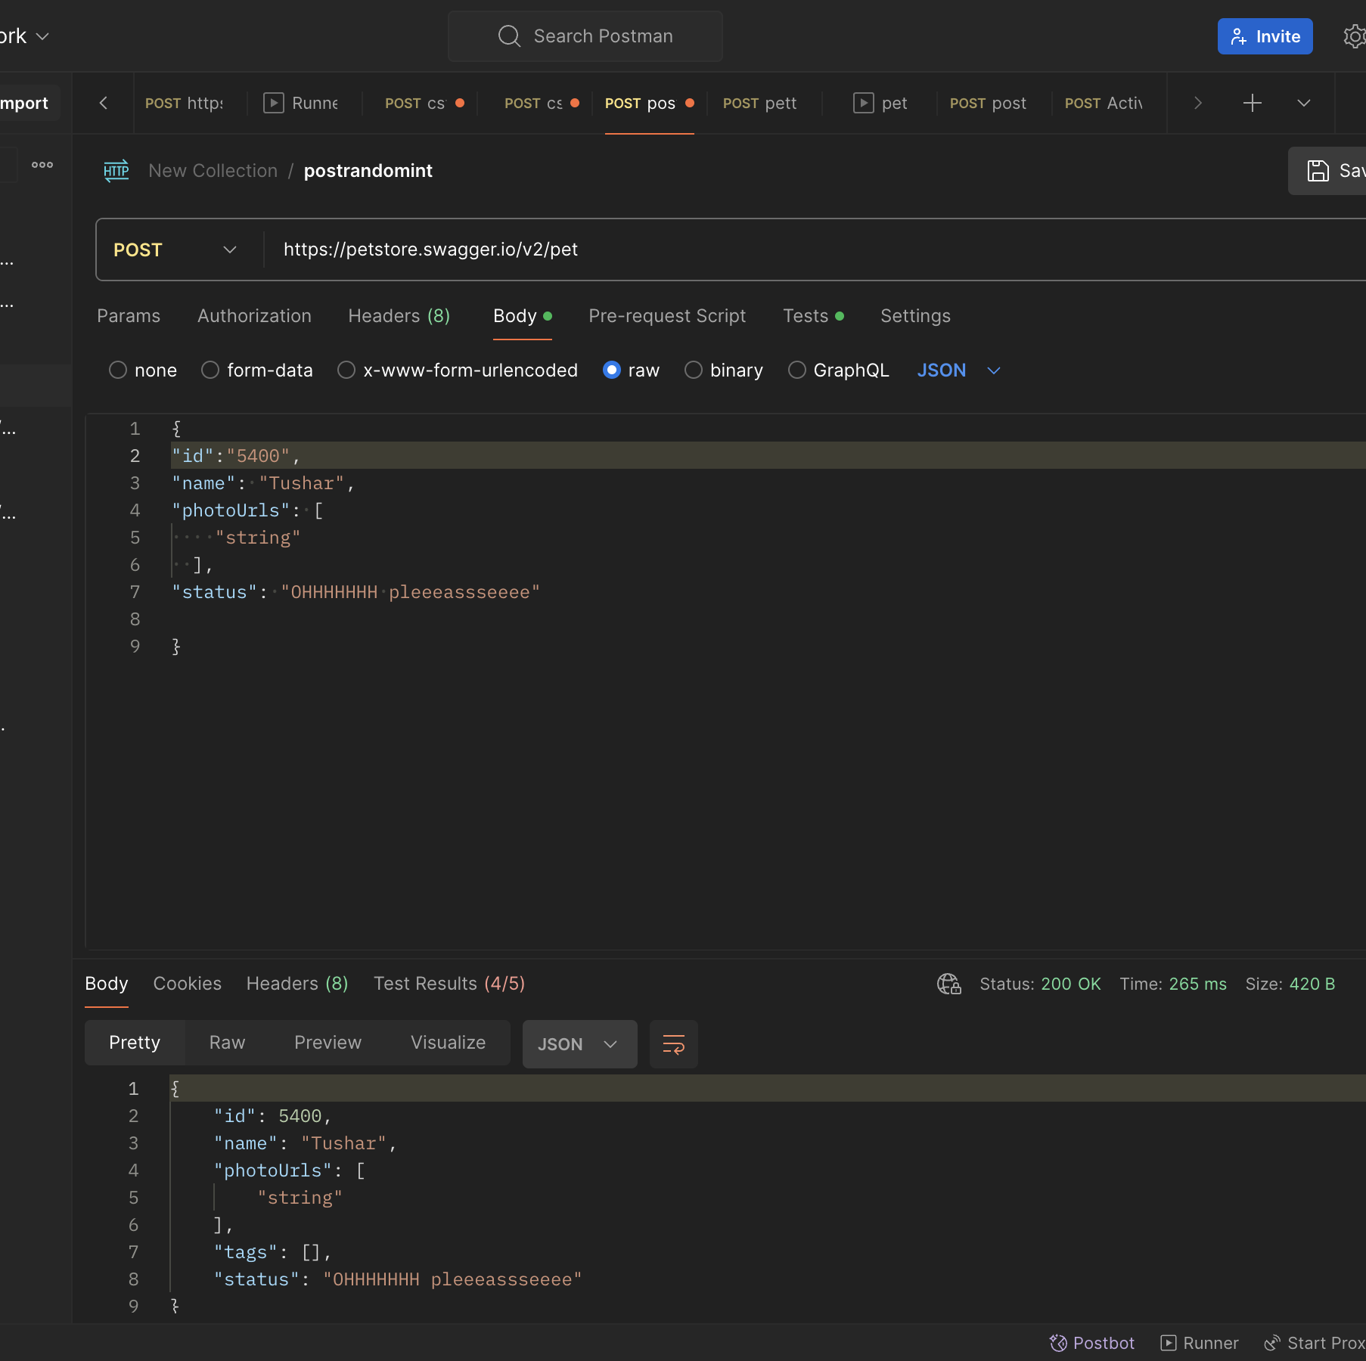
Activity-1
Summary: Adding a Pet:

Slide 6
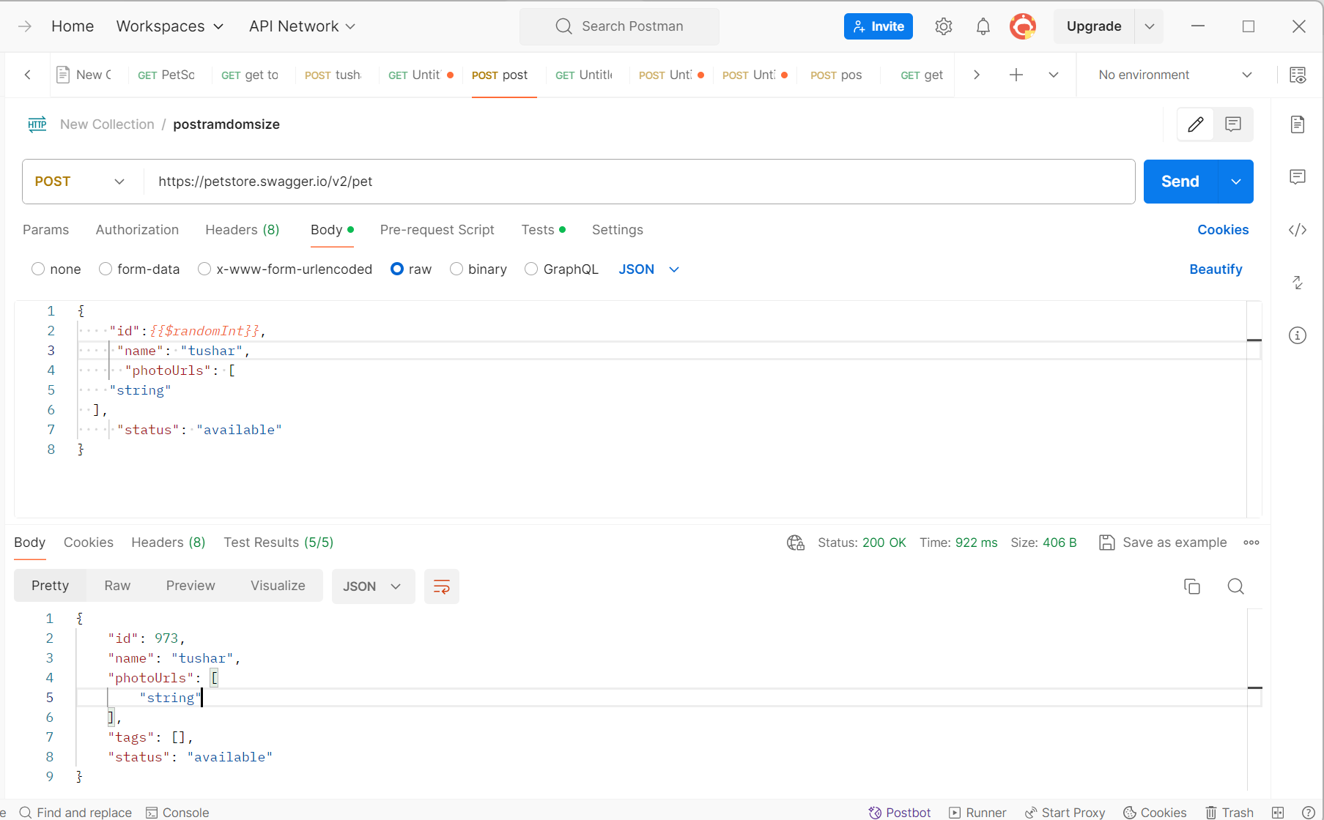
Activity-2
Summary: Adding a Pet with Random ID

Slide 7
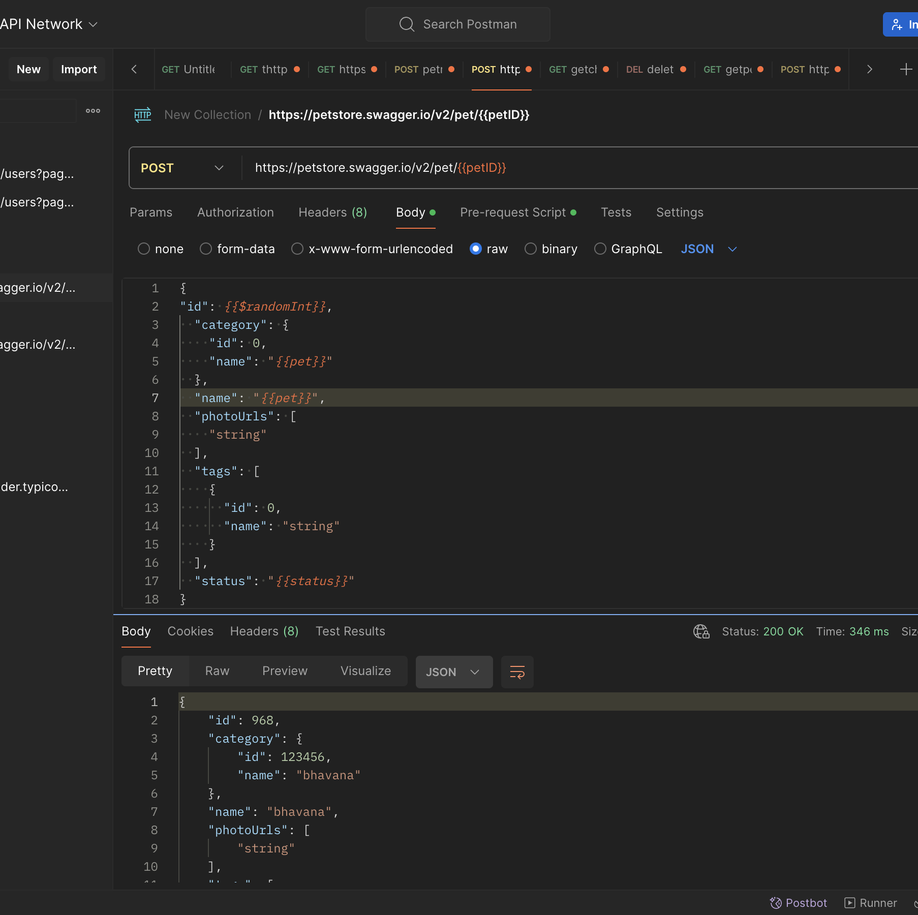
Activity-3
Summary: Adding a pet by randomizing the pet's name & status based on predefined set of values.

Slide 8
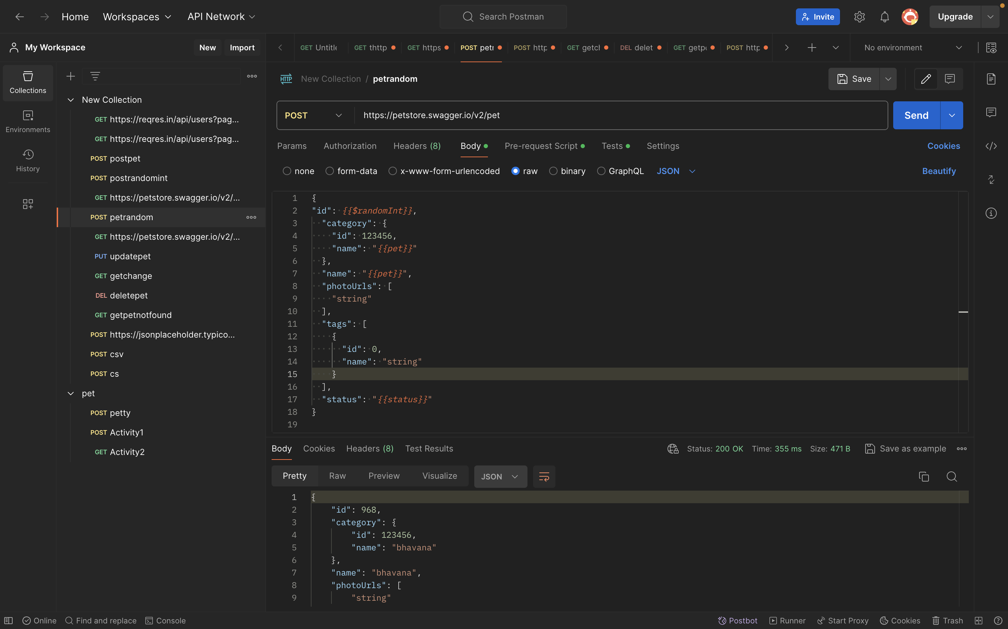
Activity-4
Summary: To Run a GET request from the randomized (pet ID) POST request using pet ID which is automated.

Slide 9
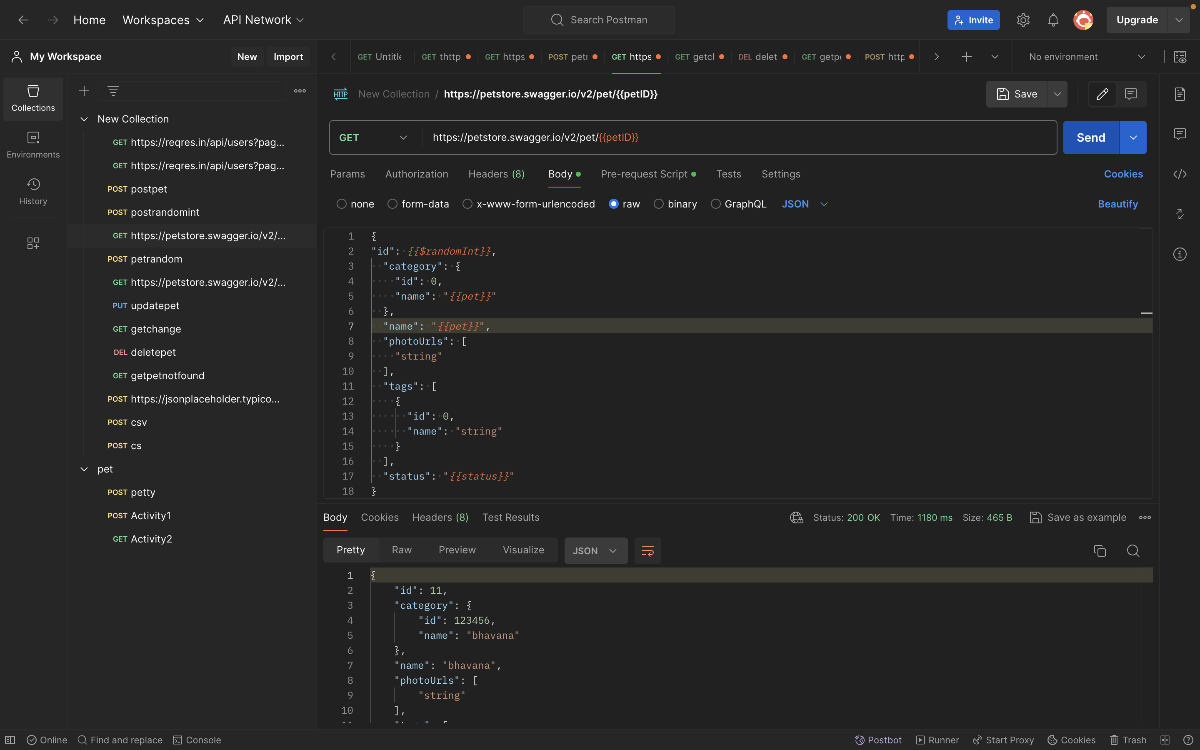
Activity-4 (Continuation)
Summary: To Run a GET request from the randomized (pet ID) POST request using pet ID which is automated.

Slide 10
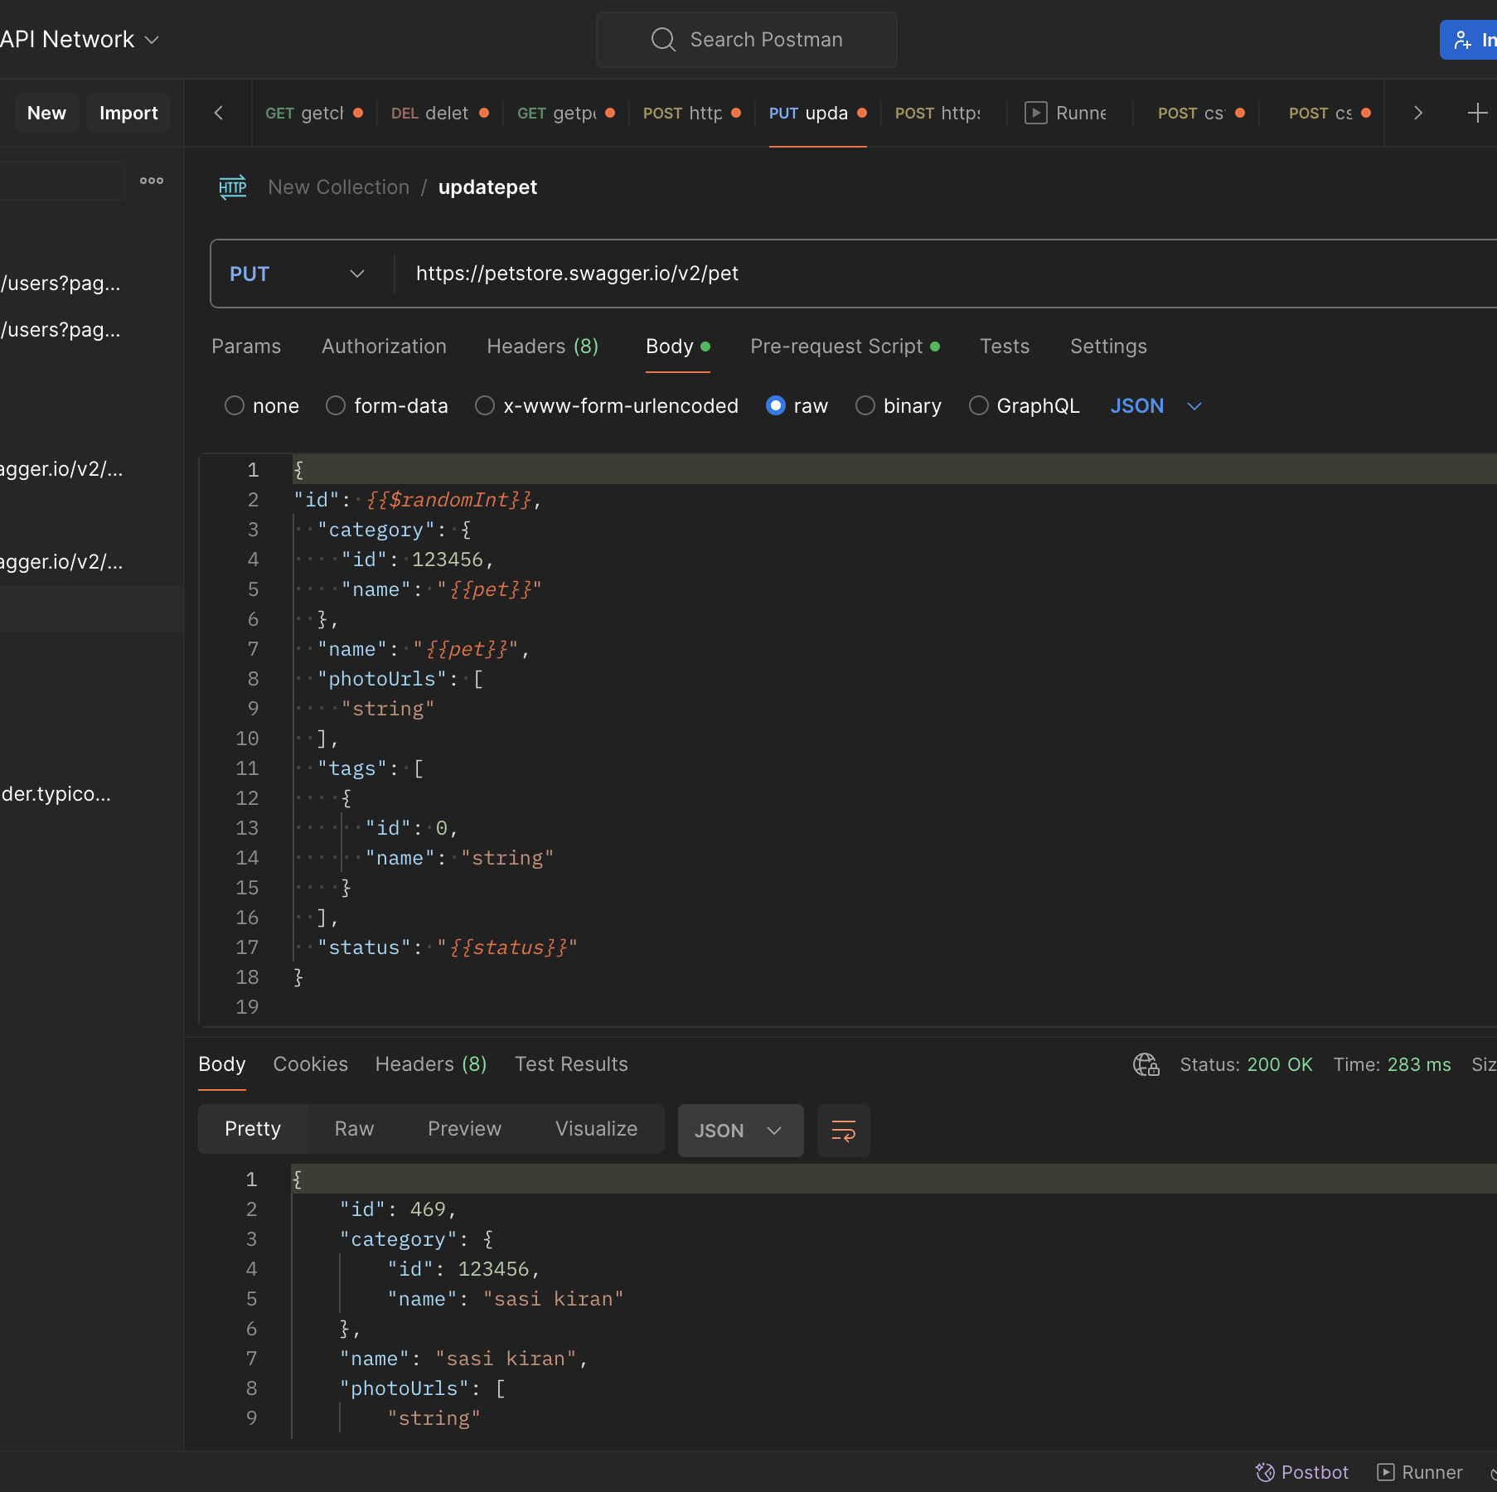
Activity-5(PUT)
Summary: Post/Get/Put/Delete operations together
.

Slide 11
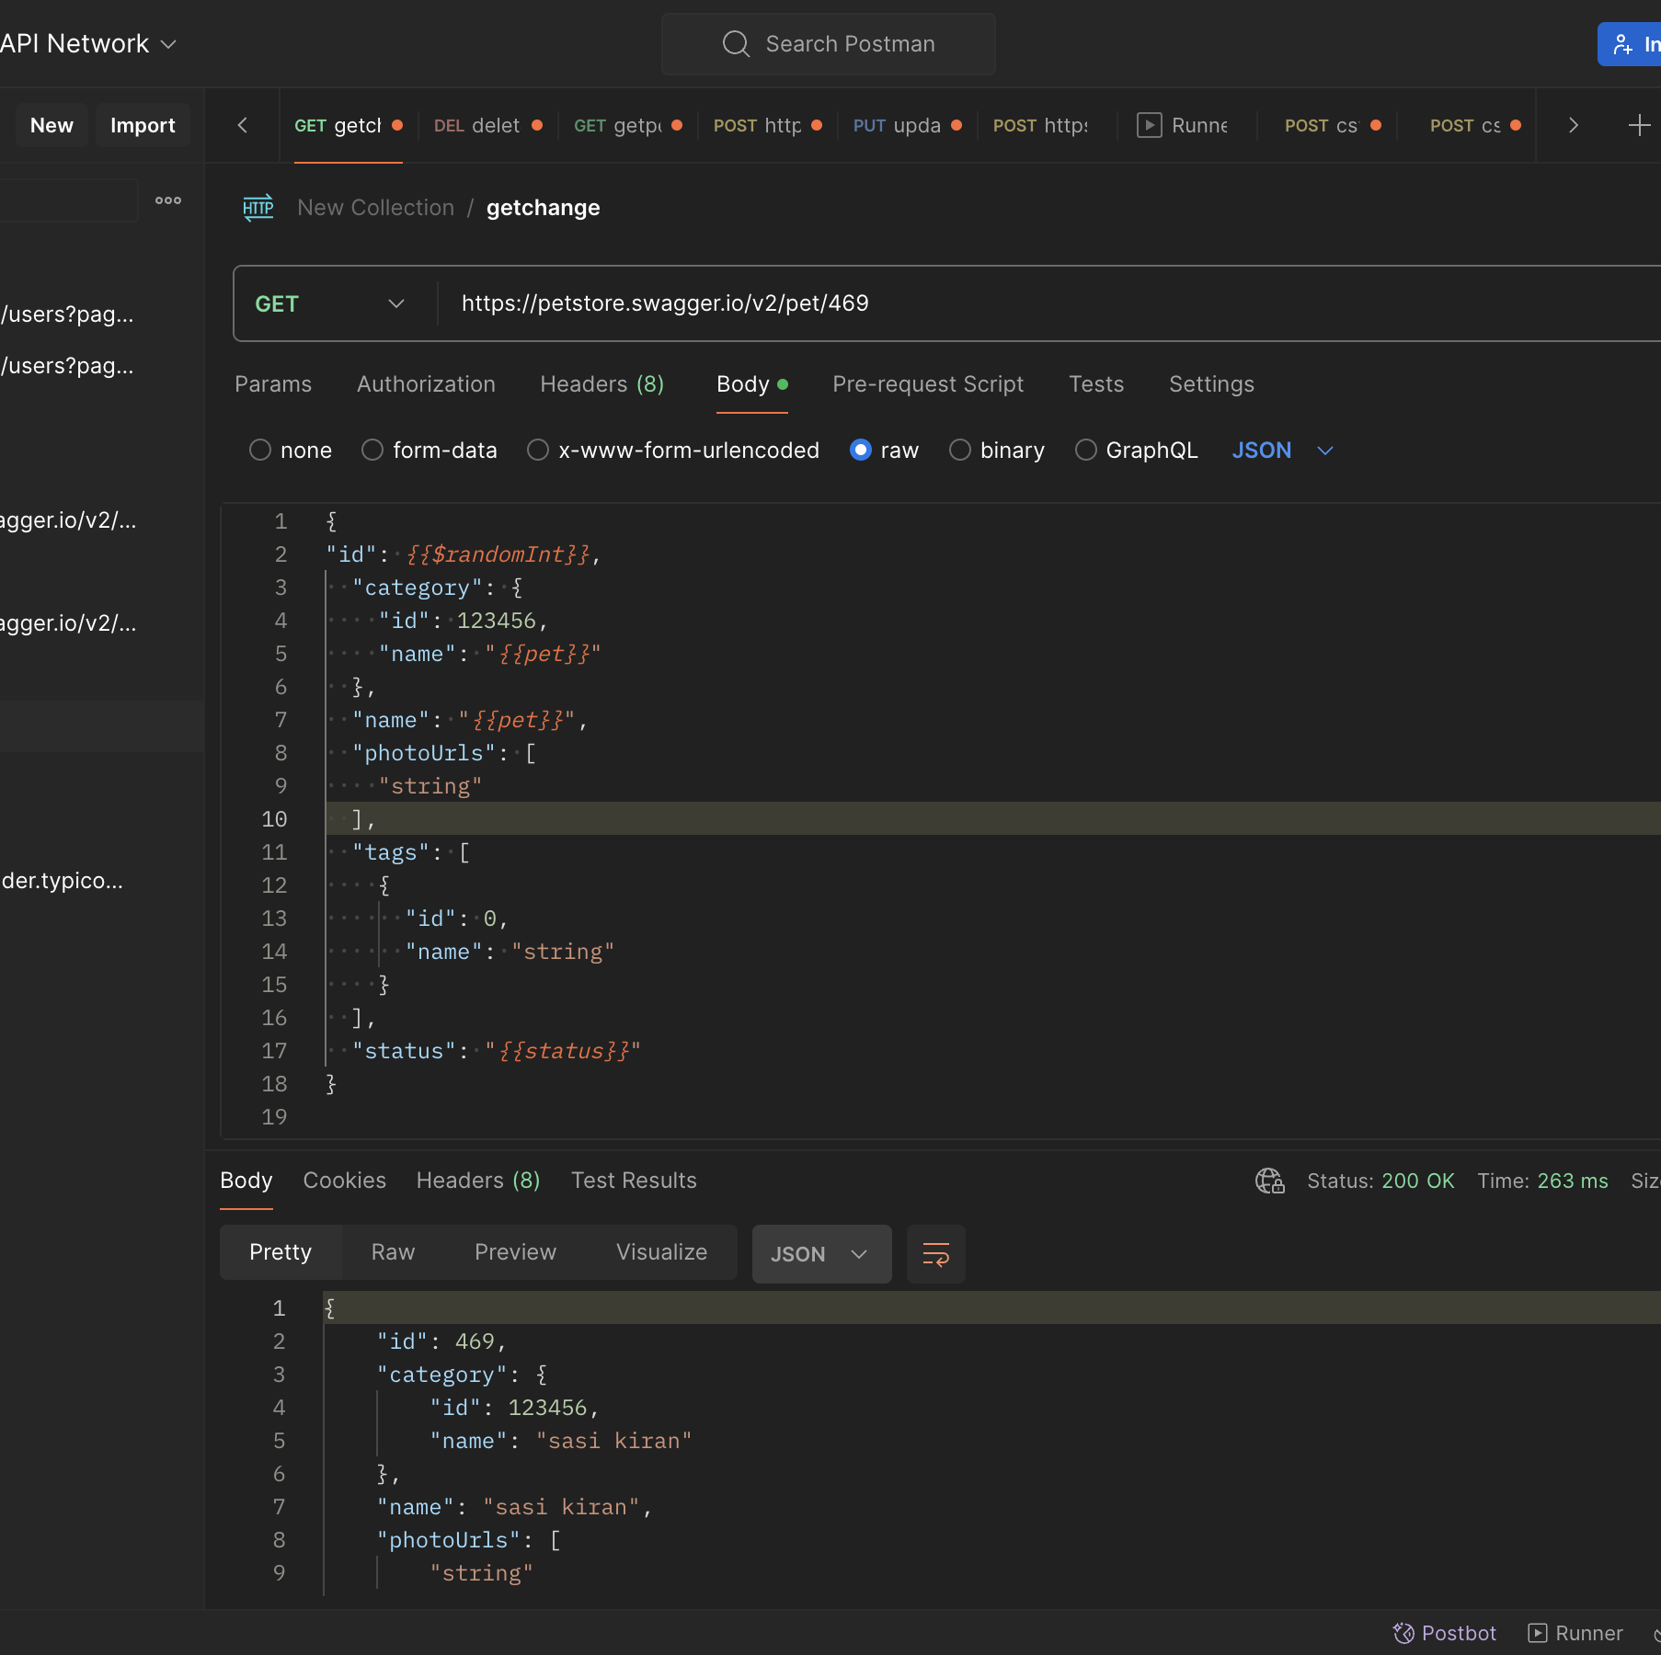
Activity-5(GET)
Summary: Post/Get/Put/Delete operations together
.

Slide 12
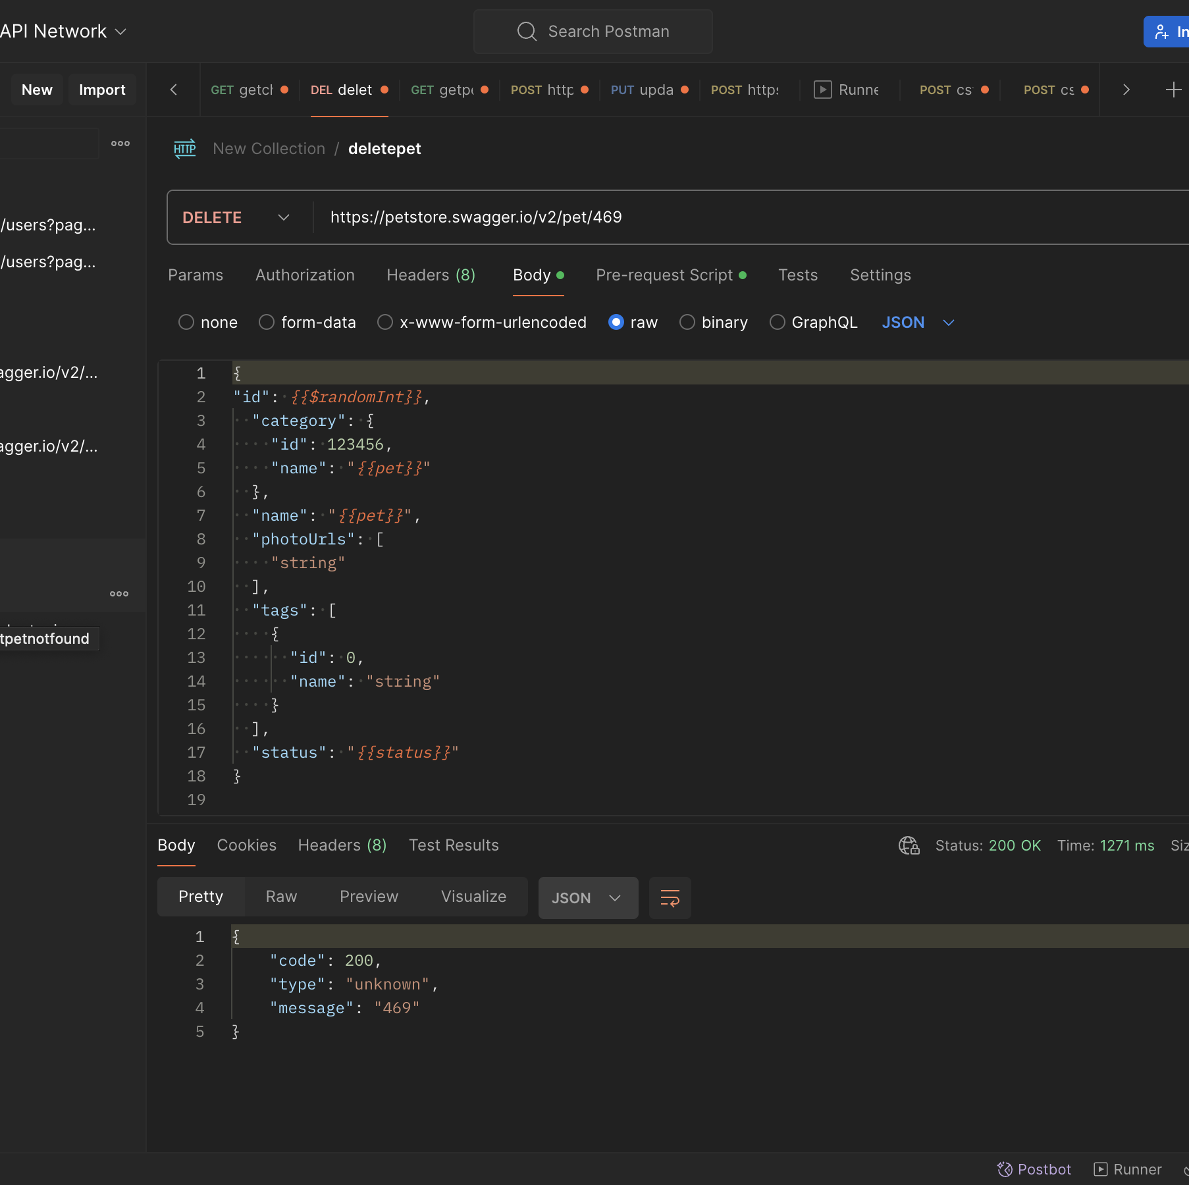
Activity-5(Delete)
Summary: Post/Get/Put/Delete operations together
.

Slide 13
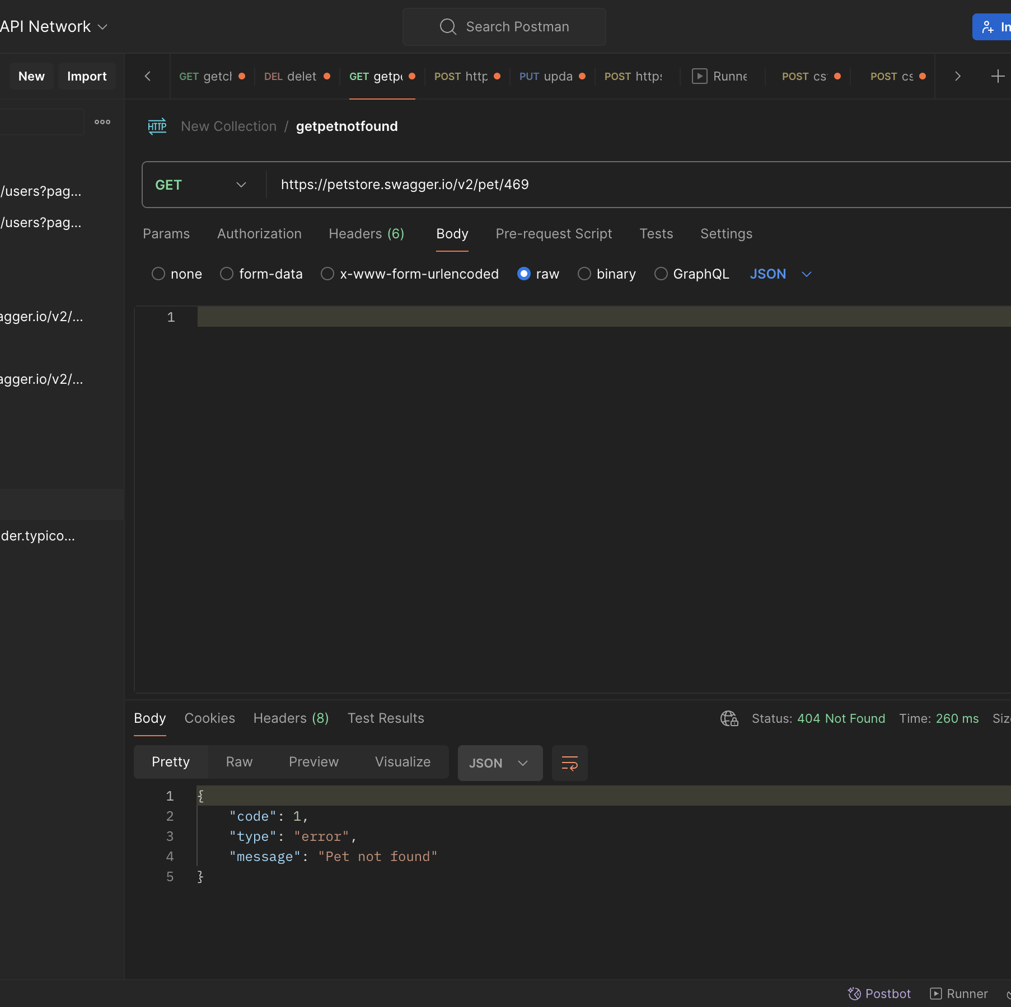
Activity-5(GET)
Summary: Post/Get/Put/Delete operations together
.

Slide 14
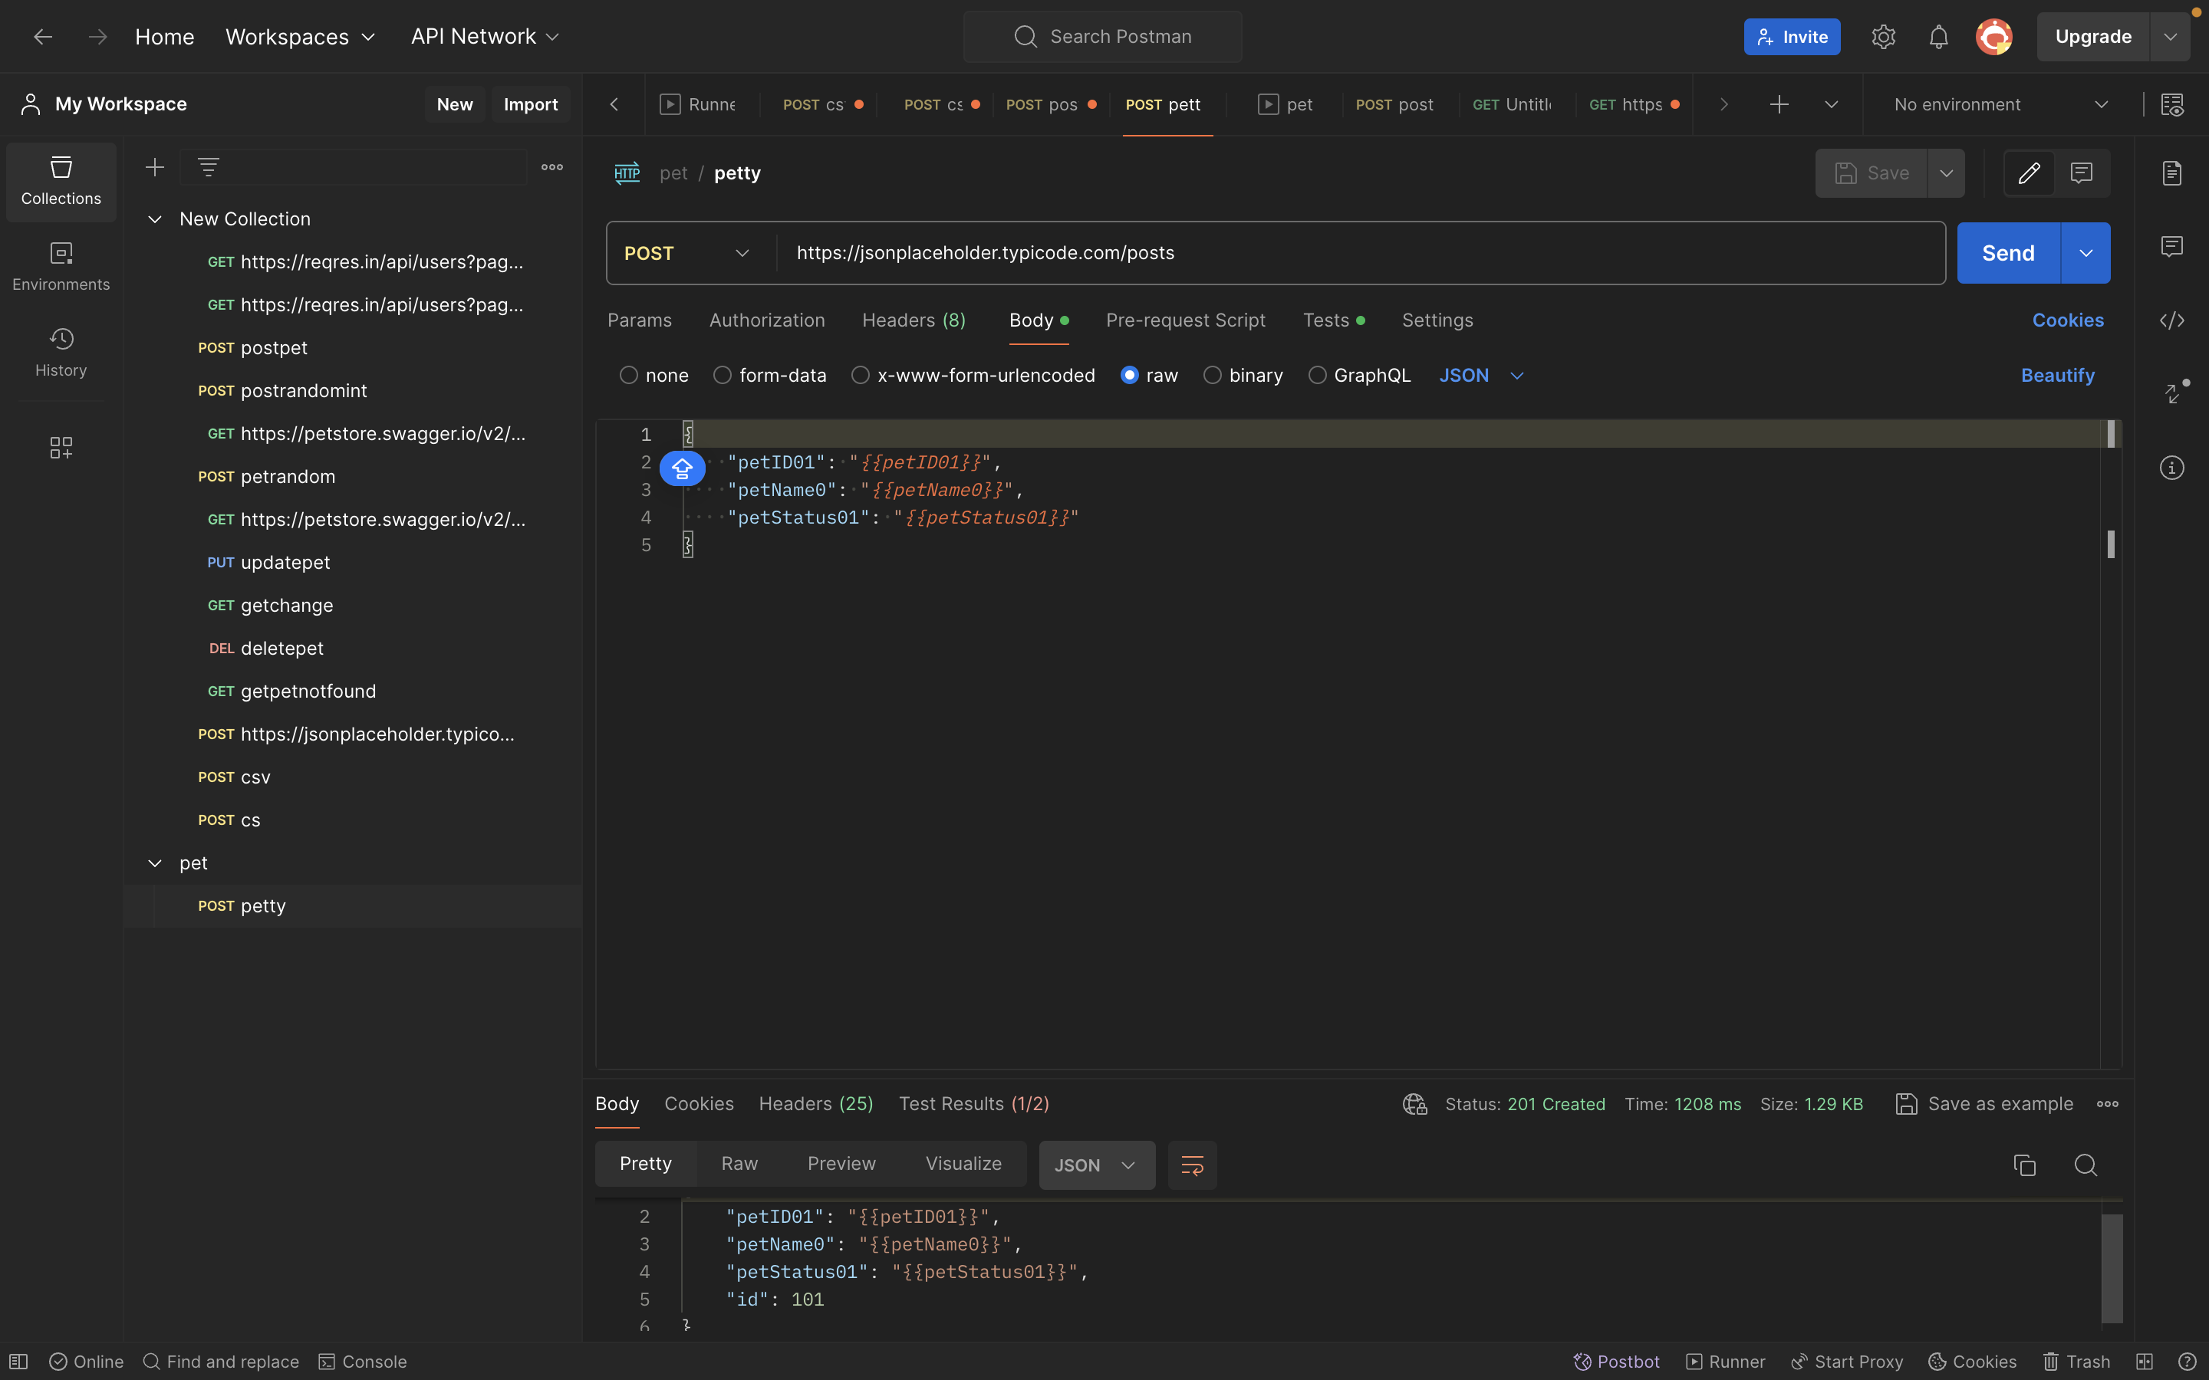
Activity-6
Summary:
Create a CSV file with test data to create POST requests. to write the data using console.log during each request.

Slide 15
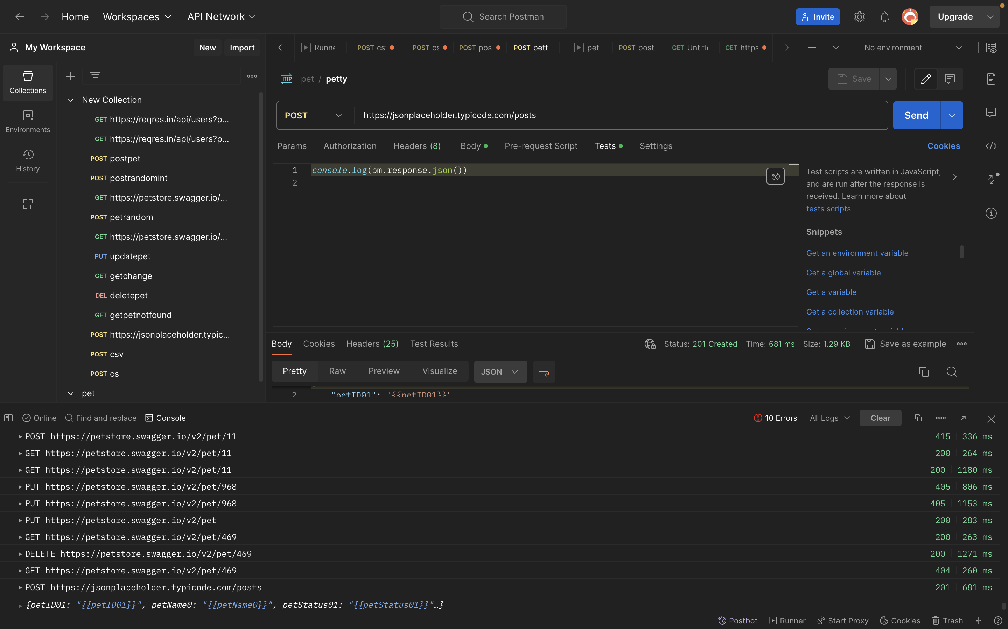
Activity-6
Summary:
Create a CSV file with test data to create POST requests. to write the data using console.log during each request.

Slide 16


